Slide 1
Schrodinger Wave Equation

Slide 2


Slide 5
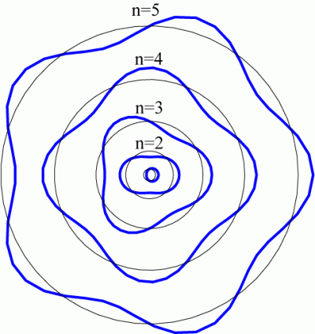

Slide 6
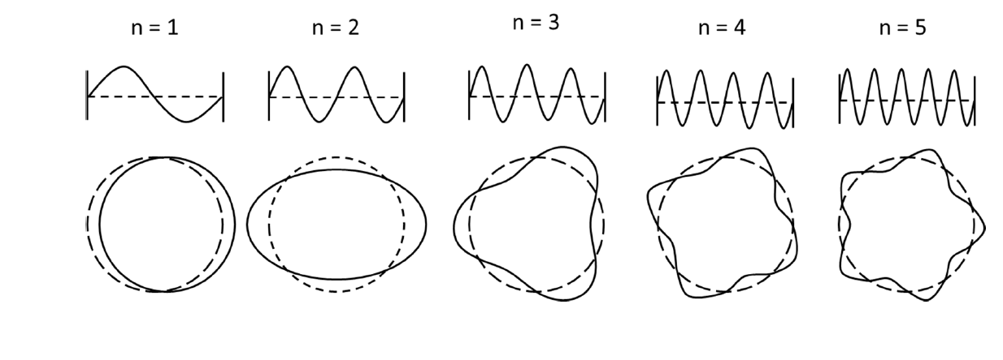

Slide 7
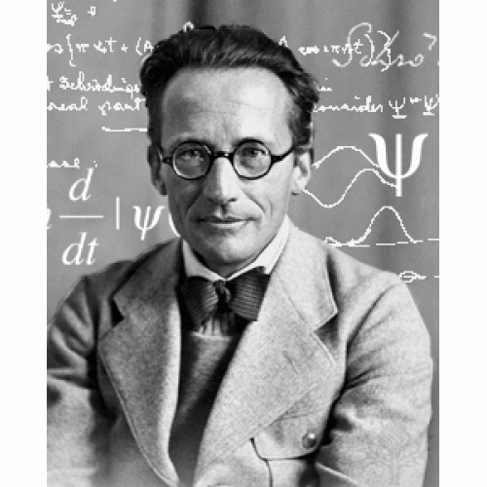
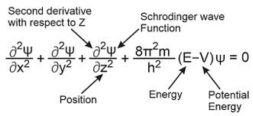

Slide 10
Physical significance of the wave function
The wave function ψ associated with a moving particle is not an observable quantity and does not have any direct physical meaning.
It is a complex quantity. The complex wave function can be represented as ψ(x, y, z, t) = a + ib and its complex conjugate as ψ*(x, y, z, t) = a – ib.

Slide 11
Physical significance of the wave function
The product of wave function and its complex conjugate is ψ(x, y, z, t)ψ*(x, y, z, t) = (a + ib) (a – ib) = a² + b² is a real quantity.

Slide 12
Physical significance of the wave function
However, this can represent the probability density of locating the particle at a place in a given instant of time. The positive square ψ(x, y, z, t) ψ*(x, y, z, t) is represented as |ψ(x, y, z, t)|, called the modulus of ψ. The quantity |ψ(x, y, z, t)|² is called the probability density

Slide 17
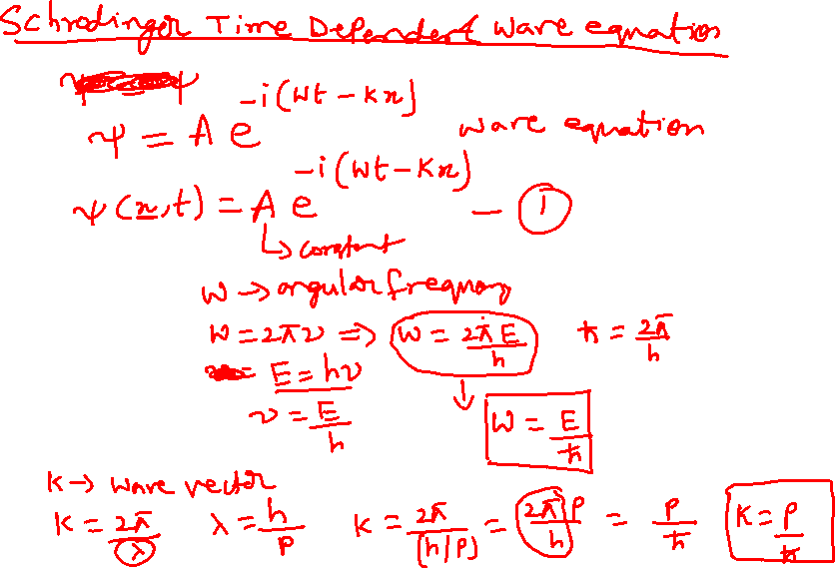

Slide 18
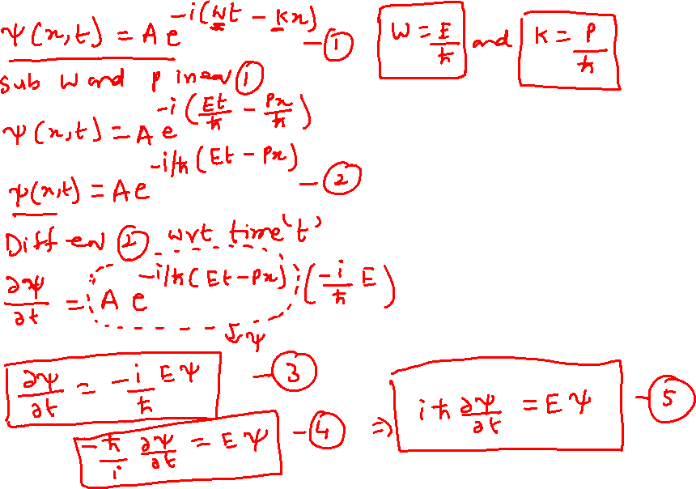

Slide 19
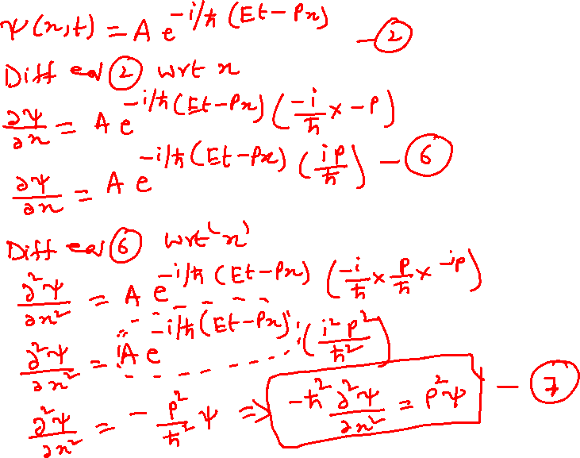

Slide 20
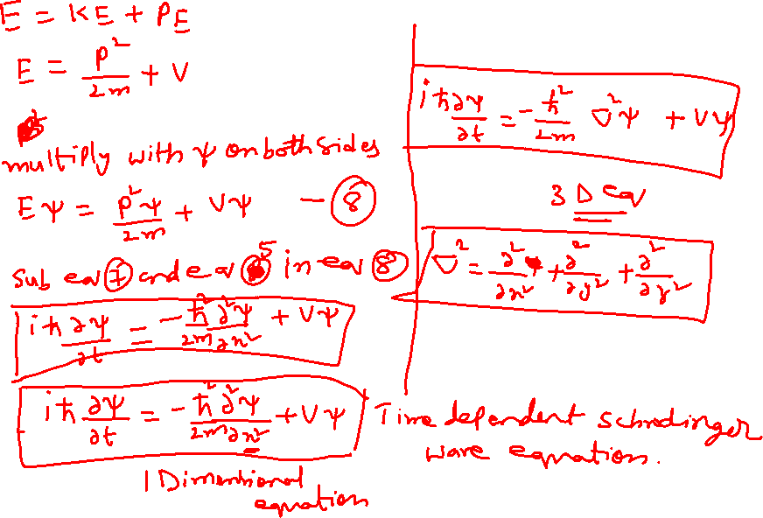

Slide 21

Standing wave equation
Ѱ=A_{o} Sin 2πx/λ----(1)
Where Ѱ wave function
Ao Amplitude
X is displacement and λ is wavelength
Differentiate eq—(1) twice w.r.t x

Slide 22
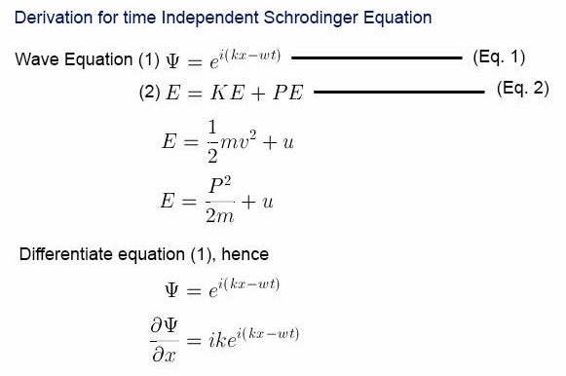

Slide 23
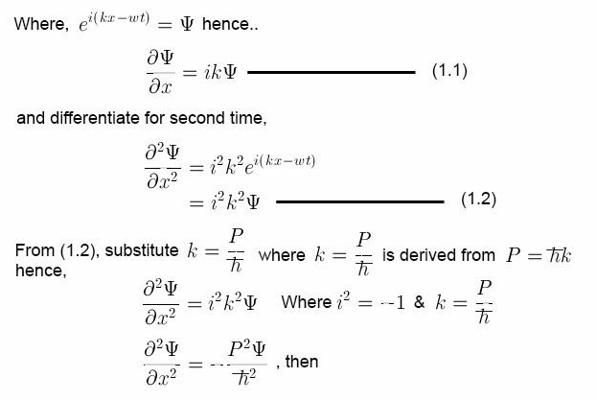

Slide 24
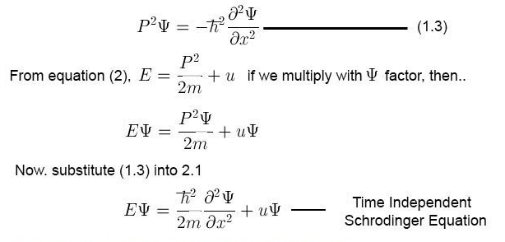

Slide 25
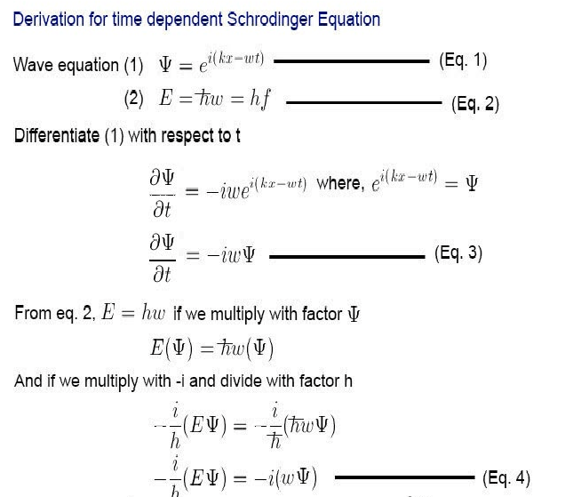

Slide 26
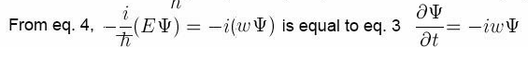
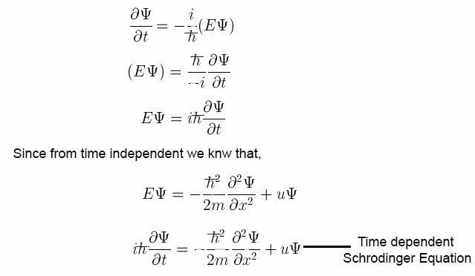

Slide 27
